Slide 1
Angular
Anil K

Slide 2
ViewChild
The “ViewChild” represents an element, which is a child of the view (template) of the component.
ViewChild is used to access an element, that is present in the view (template) of the component.
ViewChild can contain a child element of a specific type (class).
ViewChild is used to access properties / methods of the child.

Slide 3
Steps:
Import “ViewChild”:
import { ViewChild } from “@angular/core”;
Create ViewChild property:
class parentcomponent
{
@ViewChild(classname) propertyname: classname;
…
}
Access properties / methods of the child element, using ViewChild’s property:
this.propertyname.property
this.propertyname.method( )

Slide 4
ViewChild - Example
Creating Application
• Open Command Prompt and enter the following commands:
cd c:\angular
ng new app1
cd c:\angular\app1
ng g component Company
ng g component Employee

Slide 5
c:\angular\app1\src\styles.css
.class1{
border:2px solid red;
margin:10px;
padding:5px;
}
c:\angular\app1\src\app\app.component.ts
import { Component } from '@angular/core';
@Component({
selector: 'app-root',
templateUrl: './app.component.html',
styleUrls: ['./app.component.css']
export class AppComponent {
}
c:\angular\app1\src\app\app.component.html
<div class="class1>
<h4>App</h4>
<app-company></app-company>
</div>

Slide 6
c:\angular\app1\src\app\app.module.ts
import { BrowserModule } from '@angular/platform-browser;
import { NgModule } from '@angular/core’;
import { FormsModule } from "@angular/forms";
import { AppComponent } from './app.component’;
import { CompanyComponent } from './company/company.component’;
import { EmployeeComponent } from Yemployee/employee.component';
@NgModule({
declarations: [ AppComponent, CompanyComponent, EmployeeComponent ],
imports: [ BrowserModule, FormsModule ],
providers: [],
bootstrap: [AppComponent]
})
export class AppModule {}

Slide 7
c:\angular\app1\src\app\company\company.component.ts
import { Component, ViewChild } from '@angular/core’;
import { EmployeeComponent } from .../employee/employee.component';
@Component({
selector: 'app-company’,
templateUrt './company.component.html’,
styleUrls: ['./company.component.css']
export class CompanyComponent {
companyname: string = "ABC Company";
@ViewChild(EmployeeComponent) emp: EmployeeComponent;
onClickMeClicked(){
console.log(this.emp);
this.emp.empname = "John";
}
}
c:\angular\app1\src\app\company\company.component.html
<div class="class1">
<h5>Company</h5> {{companyname}}<br>
<input type="button" value="Click me" (click)="onClickMeClicked()">
<app-employee></app-employee>
</div>

Slide 8
c:\angular\app1\src\app\employee\employee.component.ts
import { Component } from '@angular/core';
@Component({
selector: 'app-employee’,
templateUrl: './employee.component.html.’,
styleUrls: ['./employee.component.css’]
export class EmployeeComponent{
empname:string = "scott";
}
c:\angular\app1\src\app\employee\employee.component.html
<div class="class1>
<h5>Employee</h5>
{{empname}}
</div>

Slide 9
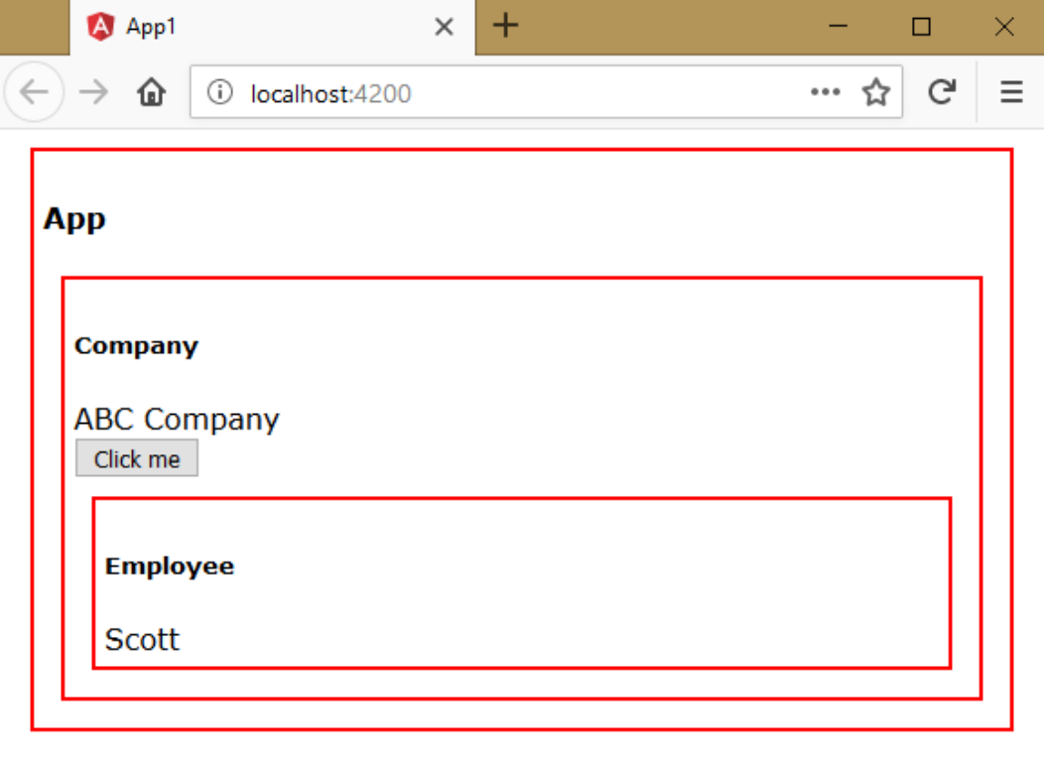
Executing the application:
• Open Command Prompt and enter the following commands:
cd c:\angular\app1
ng serve
• Open the browser and enter the following URL:
http://localhost:4200

Slide 10

• Click on “Click Me”.

Slide 11
ViewChildren
The “ViewChildren” represents a set of elements of specific type, which is a child of the view (template) of the component.
ViewChildren is used to access elements, that is present in the view (template) of the component.
ViewChildren is used to access properties / methods of the children.
Steps:
• Import “ViewChildren” and “QueryList”:
import { ViewChildren, QueryList } from “@angular/core”;
• Create ViewChildren property:
class parentcomponent
{
@ViewChildren(classname) propertyname: QueryList<classname>;
…
}
• Access properties / methods of the child element, using ViewChildren’s property:
var array = this.propertyname.toArray();
array[index].property
array[index].method( )

Slide 12
ViewChildren - Example
Creating Application
• Open Command Prompt and enter the following commands:
cd c:\angular
ng new app1
cd c:\angular\app1
ng g component Company
ng g component Employee

Slide 13
c:\angular\app1\src\styles.css
.class1{
border:2px solid red;
margin:10px;
padding:5px;
}
c:\angular\app1\src\app\app.component.ts
import { Component } from '@angular/core';
@Component({
selector: 'app-root',
templateUrl: './app.component.html',
styleUrls: ['./app.component.css']
export class AppComponent {
}
c:\angular\app1\src\app\app.component.html
<div class="class1>
<h4>App</h4>
<app-company></app-company>
</div>

Slide 14
c:\angular\app1\src\app\app.module.ts
import { BrowserModule } from '@angular/platform-browser;
import { NgModule } from '@angular/core’;
import { FormsModule } from "@angular/forms";
import { AppComponent } from './app.component’;
import { CompanyComponent } from './company/company.component’;
import { EmployeeComponent } from Yemployee/employee.component';
@NgModule({
declarations: [ AppComponent, CompanyComponent, EmployeeComponent ],
imports: [ BrowserModule, FormsModule ],
providers: [],
bootstrap: [AppComponent]
})
export class AppModule {}

Slide 15
c:\angular\app1\src\app\company\company.component.ts
import { Component, ViewChildren, QueryList } from '@angular/core’;
import { EmployeeComponent } from .../employee/employee.component';
@Component({
selector: 'app-company’,
templateUrt './company.component.html’,
styleUrls: ['./company.component.css']
export class CompanyComponent {
companyname: string = "ABC Company";
@ViewChildren(EmployeeComponent) emp: QueryList<EmployeeComponent>;
onClickMeClicked(){
console.log(this.emp);
var a = this.emp.toArray();
for(var i = 0;i<a.length;i++){
a[i].empname = "John";
}
}
}

Slide 16
c:\angular\app1\src\app\company\company.component.html
<div class="class1">
<h5>Company</h5>
{{companyname}}<br>
<input type="button" value="Click me" (click)="onClickMeClicked()">
<app-employee></app-employee>
<app-employee></app-employee>
</div>

Slide 17
c:\angular\app1\src\app\employee\employee.component.ts
import { Component } from '@angular/core';
@Component({
selector: 'app-employee’,
templateUrl: './employee.component.html.’,
styleUrls: ['./employee.component.css’]
export class EmployeeComponent{
empname:string = "scott";
}
c:\angular\app1\src\app\employee\employee.component.html
<div class="class1>
<h5>Employee</h5>
{{empname}}
</div>

Slide 18
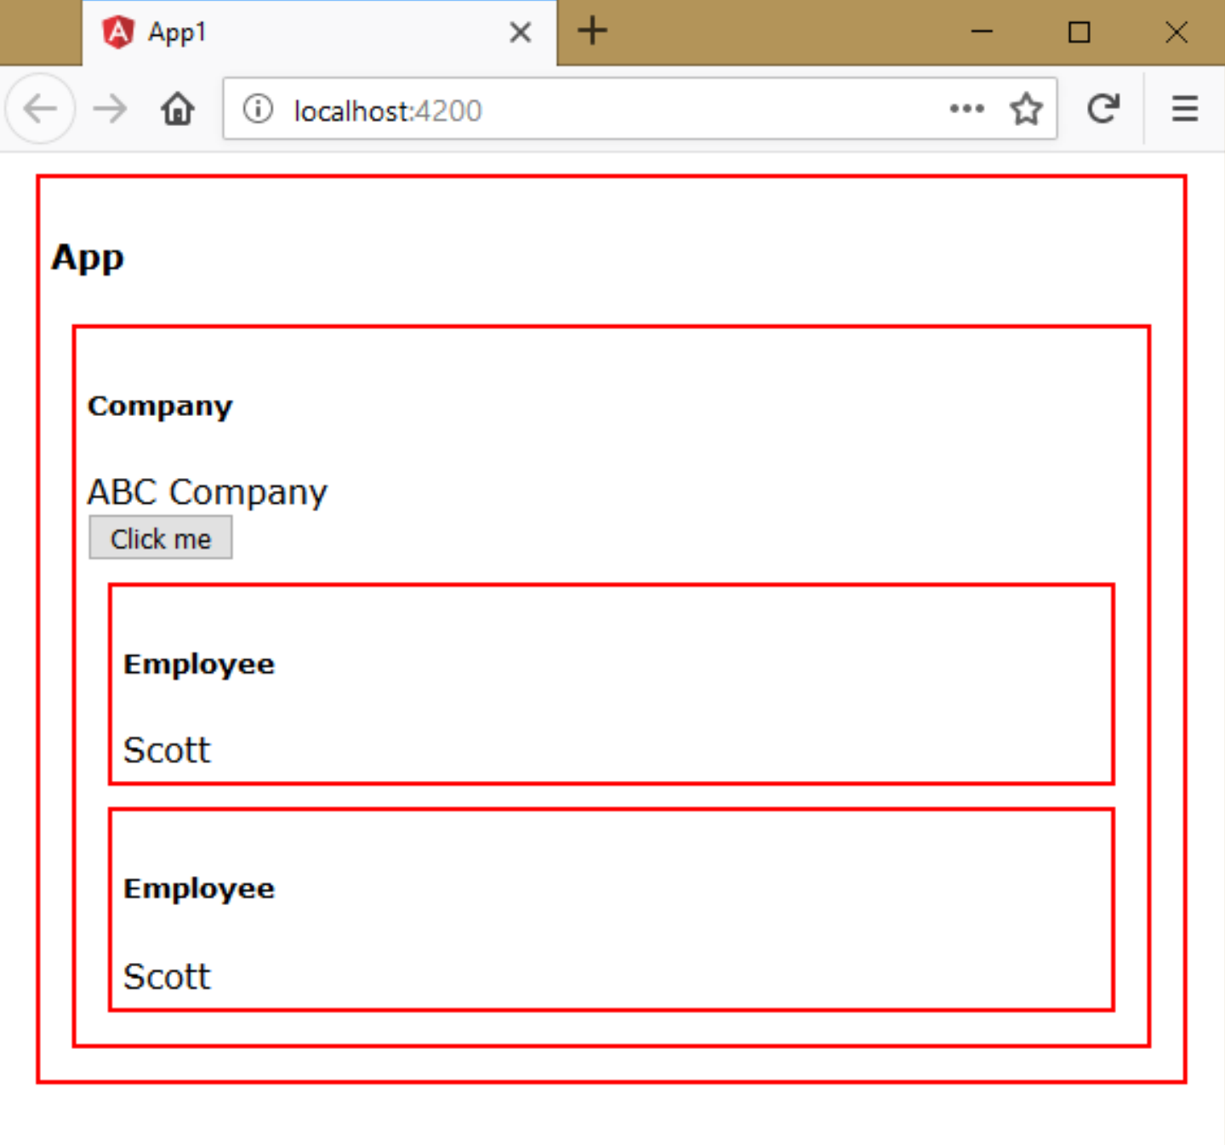
Executing the application:
• Open Command Prompt and enter the following commands:
cd c:\angular\app1
ng serve
• Open the browser and enter the following URL:
http://localhost:4200

Slide 19
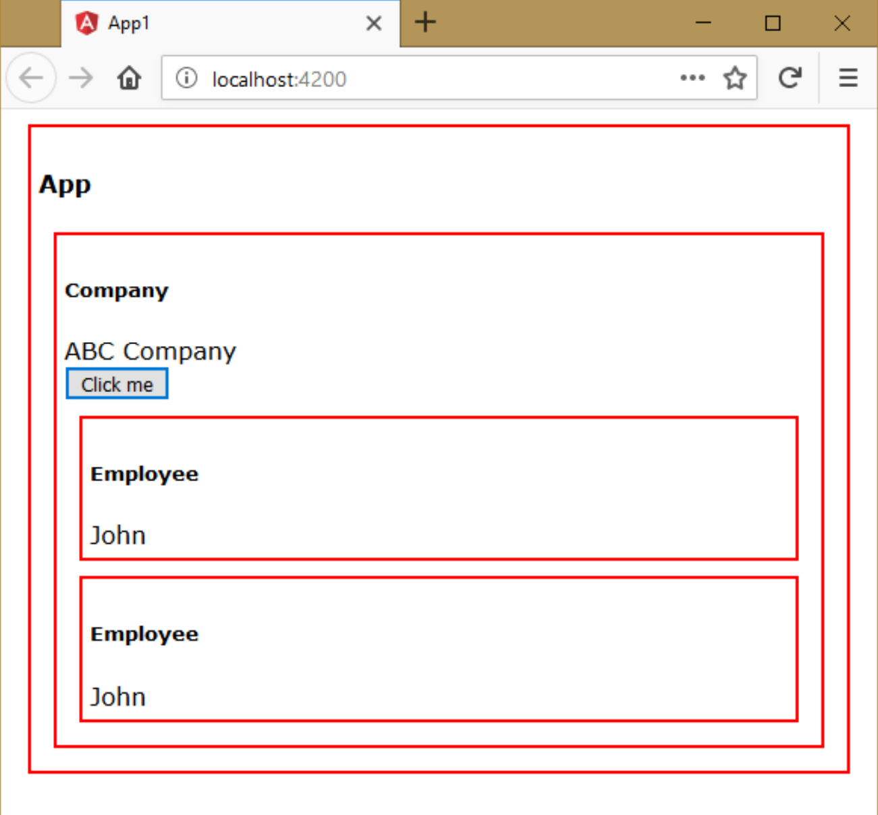
• Click on “Click Me”.

Slide 20
ContentChild
The “ContentChild” represents an element, which is a child of the content of the component.
ContentChild is used to access an element, that is present in the content of the component.
ContentChild can contain a child element of a specific type (class).
ContentChild is used to access properties / methods of the child.
Steps:
• Import “ContentChild”:
import { ContentChild } from “@angular/core”;
• Create ContentChild property:
class parentcomponent {
@ContentChild(classname) propertyname: classname;
…
}
• Access properties / methods of the child element, using ContentChild’s property:
this.propertyname.property
this.propertyname.method( )

Slide 21
ContentChild - Example
Creating Application
• Open Command Prompt and enter the following commands:
cd c:\angular
ng new app1
cd c:\angular\app1
ng g component Company
ng g component Employee

Slide 22
c:\angular\app1\src\styles.css
.class1{
border:2px solid red;
margin:10px;
padding:5px;
}
c:\angular\app1\src\app\app.component.ts
import { Component } from '@angular/core';
@Component({
selector: 'app-root',
templateUrl: './app.component.html',
styleUrls: ['./app.component.css']
export class AppComponent {
}
c:\angular\app1\src\app\app.component.html
<div class="class1>
<h4>App</h4>
<app-company>
<app-employee></app-employee>
</app-company>
</div>

Slide 23
c:\angular\app1\src\app\app.module.ts
import { BrowserModule } from '@angular/platform-browser;
import { NgModule } from '@angular/core’;
import { FormsModule } from "@angular/forms";
import { AppComponent } from './app.component’;
import { CompanyComponent } from './company/company.component’;
import { EmployeeComponent } from Yemployee/employee.component';
@NgModule({
declarations: [ AppComponent, CompanyComponent, EmployeeComponent ],
imports: [ BrowserModule, FormsModule ],
providers: [],
bootstrap: [AppComponent]
})
export class AppModule {}

Slide 24
c:\angular\app1\src\app\company\company.component.ts
import { Component, ContentChild } from '@angular/core’;
import { EmployeeComponent } from .../employee/employee.component';
@Component({
selector: 'app-company’,
templateUrt './company.component.html’,
styleUrls: ['./company.component.css']
export class CompanyComponent {
companyname: string = "ABC Company";
@ ContentChild(EmployeeComponent) emp: EmployeeComponent;
onClickMeClicked(){
console.log(this.emp);
this.emp.empname = "John";
}
}

Slide 25
c:\angular\app1\src\app\company\company.component.html
<div class="class1">
<h5>Company</h5>
{{companyname}}<br>
<input type="button" value="Click me" (click)="onClickMeClicked()">
<ng-content></ng-content>
</div>

Slide 26
c:\angular\app1\src\app\employee\employee.component.ts
import { Component } from '@angular/core';
@Component({
selector: 'app-employee’,
templateUrl: './employee.component.html.’,
styleUrls: ['./employee.component.css’]
export class EmployeeComponent{
empname:string = "scott";
}
c:\angular\app1\src\app\employee\employee.component.html
<div class="class1>
<h5>Employee</h5>
{{empname}}
</div>

Slide 27

Executing the application:
• Open Command Prompt and enter the following commands:
cd c:\angular\app1
ng serve
• Open the browser and enter the following URL:
http://localhost:4200

Slide 28

• Click on “Click Me”.

Slide 29
ContentChildren
The “ContentChildren” represents a set of elements of specific type, which is a child of the content of the component.
ContentChildren is used to access elements, that is present in the content of the component.
ContentChildren is used to access properties / methods of the children.
Steps:
Import “ContentChildren” and “QueryList”:
import { ContentChildren, QueryList } from “@angular/core”;
• Create ContentChildren property:
class parentcomponent
{
@ContentChildren(classname) propertyname: QueryList<classname>;
…
}
• Access properties / methods of the child element, using ContentChildren’s property:
var array = this.propertyname.toArray();
array[index].property
array[index].method( )

Slide 30
ContentChildren - Example
Creating Application
• Open Command Prompt and enter the following commands:
cd c:\angular
ng new app1
cd c:\angular\app1
ng g component Company
ng g component Employee

Slide 31
c:\angular\app1\src\styles.css
.class1{
border:2px solid red;
margin:10px;
padding:5px;
}
c:\angular\app1\src\app\app.component.ts
import { Component } from '@angular/core';
@Component({
selector: 'app-root',
templateUrl: './app.component.html',
styleUrls: ['./app.component.css']
export class AppComponent {
}
c:\angular\app1\src\app\app.component.html
<div class="class1>
<h4>App</h4>
<app-company>
<app-employee></app-employee>
<app-employee></app-employee>
</app-company>
</div>

Slide 32
c:\angular\app1\src\app\app.module.ts
import { BrowserModule } from '@angular/platform-browser;
import { NgModule } from '@angular/core’;
import { FormsModule } from "@angular/forms";
import { AppComponent } from './app.component’;
import { CompanyComponent } from './company/company.component’;
import { EmployeeComponent } from Yemployee/employee.component';
@NgModule({
declarations: [ AppComponent, CompanyComponent, EmployeeComponent ],
imports: [ BrowserModule, FormsModule ],
providers: [],
bootstrap: [AppComponent]
})
export class AppModule {}

Slide 33
c:\angular\app1\src\app\company\company.component.ts
import { Component, ContentChildren, QueryList } from '@angular/core’;
import { EmployeeComponent } from .../employee/employee.component';
@Component({
selector: 'app-company’,
templateUrt './company.component.html’,
styleUrls: ['./company.component.css']
export class CompanyComponent {
companyname: string = "ABC Company";
@ConentChildren(EmployeeComponent) emp: QueryList<EmployeeComponent>;
onClickMeClicked(){
console.log(this.emp);
var a = this.emp.toArray();
for(var i = 0;i<a.length;i++){
a[i].empname = "John";
}
}
}

Slide 34
c:\angular\app1\src\app\company\company.component.html
<div class="class1">
<h5>Company</h5>
{{companyname}}<br>
<input type="button" value="Click me" (click)="onClickMeClicked()">
<ng-content></ng-content>
</div>

Slide 35
c:\angular\app1\src\app\employee\employee.component.ts
import { Component } from '@angular/core';
@Component({
selector: 'app-employee’,
templateUrl: './employee.component.html.’,
styleUrls: ['./employee.component.css’]
export class EmployeeComponent{
empname:string = "scott";
}
c:\angular\app1\src\app\employee\employee.component.html
<div class="class1>
<h5>Employee</h5>
{{empname}}
</div>

Slide 36
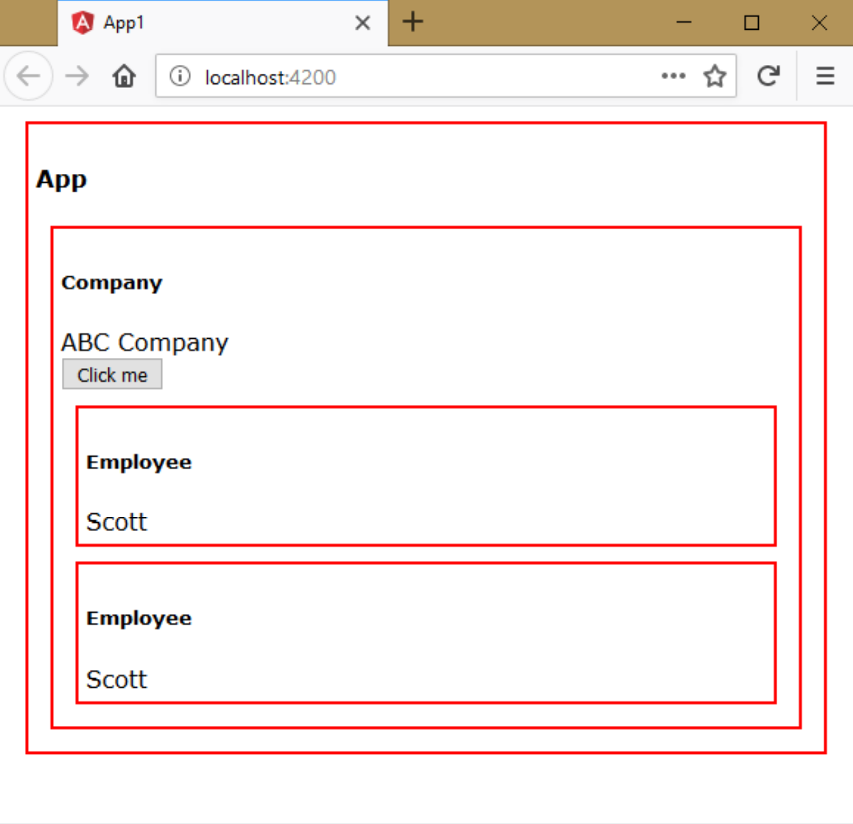
Executing the application:
• Open Command Prompt and enter the following commands:
cd c:\angular\app1
ng serve
• Open the browser and enter the following URL:
http://localhost:4200

Slide 37

• Click on “Click Me”.

